Slide 1

Softball Mechanics
Questions – Answers
OBJECTIVE To Achieve -
Good Mechanics separates the best of Amateur Umpires from a Professional Umpire

Slide 2
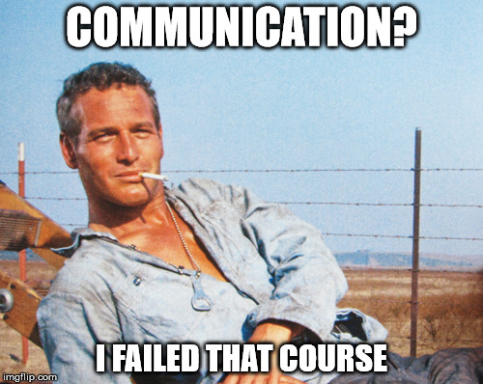
Communication
Definition:
Meaning?
2 People
Sender
Receiver
Has only occurred when the receiver has understood what the sender has sent
Do you understand why? WHY?
Notes:
* Add Failure to Communicate Meme

Slide 3
Pre-Game (With partner(s) and Coaches and Captains)
Meeting with Partner(s) (Page 12, Umpires Manual)
Signals (verbal & non-verbal) What are they? Outs, infield fly, count, etc.
How we Communicate!
Mechanics (Where do you stand between innings, start of pitch no-one on?))
Coverage (triple, fly balls) – Who says What? Even if you KNOW your partner.
1-3 improvement goals – Do I want to get better or is where I am OK? (Non-Book)
Coaches & Captains (What needs to be covered-WHY?) (Page 13, Umpire Manual)
See Casey’s Presentation
Keep it short
Ground Rules (Who is responsible?) Can you ask the coach to explain?
Certify Lineup (DP/Flex)
Legally & Properly Equipped (IF ASKED- do we check equipment?)
Points of Emphasis (Illegal bats-damaged bats, Pivot foot contact vs top of, Preceding runner-appeal, etc.)
Notes:
Mechanics: Triple that Base can’t get there
Base to Plate about Fly ball
When to talk about pulled foot
Fly ball coverage, who has what?
Base goes out, don’t stay out, follow ball back in to help
2nd Call at 3rd
When to give the count?

Slide 4
Mechanics - General
Who
Who covers What? Which areas of the field??
What
Are you certain on what you have to do in any and all situations? (Pre-pitch thought)
Where
Are you sure of where you have to be when (ground balls, fly balls, runners on base, etc.?)
Where should your eyes be, how far away from the play? 10-12 ft UM p 41 Rundowns 12-15 ft-UM p 34 and parallel?, Tag ups- does the Plate always have the lead runner? UM p 40
Why
Do I have to be there? What is the wedge? Any other way to describe it? UM p 39
Hustle
Jog, run, walk with a purpose- do you know when to do either? (UM p 15) (Refer to Game Management Presentation)

Slide 5
Plate Mechanics (Umpires Manual P 17,19, 19-27)
Position (video) and (Art Corral’s Presentation)
Slot or above the catcher head? When, Why, Why Not? (Page 19- Rule Book)
Movement
Why do you leave the catcher on the left (normally) and follow the runner toward 1st? How Far? (Page 23-Rule Book and Page 222 Umpires Manual))
When do you not follow the batter/base runner toward 1st? Where do you go?
When do you go toward or to the pitchers circle?
When do you go to the holding area?
Whoa, where are you located on a close tag at the plate? Does it matter where the ball is coming from?
When you call fly balls (out-safe where are you?) Where should you be? (Page 40, Umpires Manual)
Responsibilities
Fly ball coverage? Runners on 1-3, oops it’s now one-Person (Base went out) (Page 40, Rule Book)
When do you have 3rd base on a call? Always?
What else are you responsible for? Balls, strikes, fair foul, ????? (Page 19, Umpires Manual)

Slide 6
Plate Mechanics (Continued)
Situations
Runner on 2nd, base umpire goes out on a fly ball to left field. Where do you go? (Page 43, Rule Book)
No one on- batter hits a triple, “I got third- is that OK? (Advanced Skill and a Pre-game discussion)
If not, why not?
Pop-up foul ball behind the plate- Do I follow the ball OR catcher? (Advanced Skill)
Following a batter/base runner toward 1st; saw a pulled foot. Out called. Your response?(Page 32, Umpires Manual)- Can the Base Umpire ask before his/her call?
Catcher asks - where was that pitch (for the 4th time) What do you do/say?
Coach yells from the dugout (3rd time)- where was that pitch? Your response??
Half Swings-When do you ask for help? Do you have to? Why – Why not?
Where is the base umpire? Does it make a difference where they are?
Can you, should you change your call? (Advanced Skill)

Slide 7
Base Umpire (General, Page 29-34 Umpires Manual)
Position (video)
Movement
Walk the line (Starting from where?) No one on - call at 1st- your location?
Double , triple (Can the plate take it with no-one on?)
Inside-outside theory What’s that? Why?
Buttonhook or rim. Which is better and why?
Chase fly balls. Always? When do you chase? Do you signal anything?
Can you make a call from foul territory? When? (Advanced Skill and foul ground theory)
Is the angle more important than distance? (Advanced Skill)
Responsibilities
All the safe and outs at 1st, 2nd and 3rd ????? If not, then which ones?
All fly balls????? When do you go out?
What signal do you give?
Did this get pre-gamed?

Slide 8
Base Mechanics (Continued)
Responsibilities (Continued)
Assist with half swings by batter when asked. By who and what/how do you respond?
Coach, catcher, etc.
Situations
Base umpire went out on shallow fly ball, runners on bases, made call – can he/she come back? Or can they just look to see id they can help- on an appeal, etc.(Can you pre-game this?
Where do you expect the plate umpire to be when you chase fly balls; runner on first, second, third etc.? (Advanced Skill)
Between innings, plate umpire is changing line-up, talking to coach – are you counting pitches? Does it matter?
Steal - close call at 2nd ; coach comes out screaming she is safe not out – what is your response?, what can you do? What should you do? Do you ask the coach anything?
Runner on 1st,batter/base runner hits ball to shortstop, she throws to 2nd for the force out, runner slides, pops up waves her hand and deflects the throw to 1st. What have you got? Whose call? UM p35

Slide 9
Signals (Page 66, Umpires Manual)
How often and how do you look at your indicator? (After every pitch?) Why - Why Not?
How often and WHEN do you give the count? (3-4 reasons?)
Catcher/pitcher asks, coach asks and when there is a play (Steal) infield for base umpire, numerous foul balls, 3-X), X-2
Outs to your partner? Timing play or not with 2 outs. (tap on wrist 2 fingers)
Is there a difference between routine and “close” plays? Sell it or not - why?
Safe, Out, infield fly, obstruction, interference, time, play ball, foul tip, foul ball, fair ball, illegal pitch, delayed dead ball, base award(s), hold up play, “Help on a half swing, etc.)
Can you explain your call to the coach, coaches? H. McCarney’s presentation
Did you pre-game with your partner? If not, why not? Oh an experienced pro and we don’t need it!

Slide 10
Miscellaneous
How many pitches before the game starts? Between Innings? Can you allow more? *When? (Page 53, Rule 6-3)
Why does the base umpire clean the plate before the start of the game? (Advanced Skill)
We look like what we are – professional or not? Does it matter? (Page 15, Umpires Manual)
Behind you Mom/Dad giving you heck! What should/can you do? Ever talk to fans?
You ever talk with coach or coaches between innings? Both or just one? (Page 11, Umpires Manual)
Hustle (jog, run, walk with a purpose) Why? (Page 15, Umpires Manual)
Coach comes to plate and askes you to help base umpire that she said missed the call? *Your response! After the dust settles, did you talk between the inning about the call?
Players on bases leaving early on pitch- whose responsibility? Same as fly ball tag ups?

Slide 11
Post Game (Page 15-16, Umpires Manual)
So, how did the game go?
Any complaints from the coach(s) or Fans? Do you care?
Any calls or situations that need or should be talked about?
Was our signals and coverage OK – right distance, angles, etc.
you and I could have done better or not?
What Friction Points – Let’s be honest- I would have like you to have done …………….
Close Plays – Were they OK, Were they SOLD?, any help needed?
Here are honest comments on your performance and I need you to tell me about mine!
What can I approve on? How can we approve as a team?
I really like how you………

Slide 12
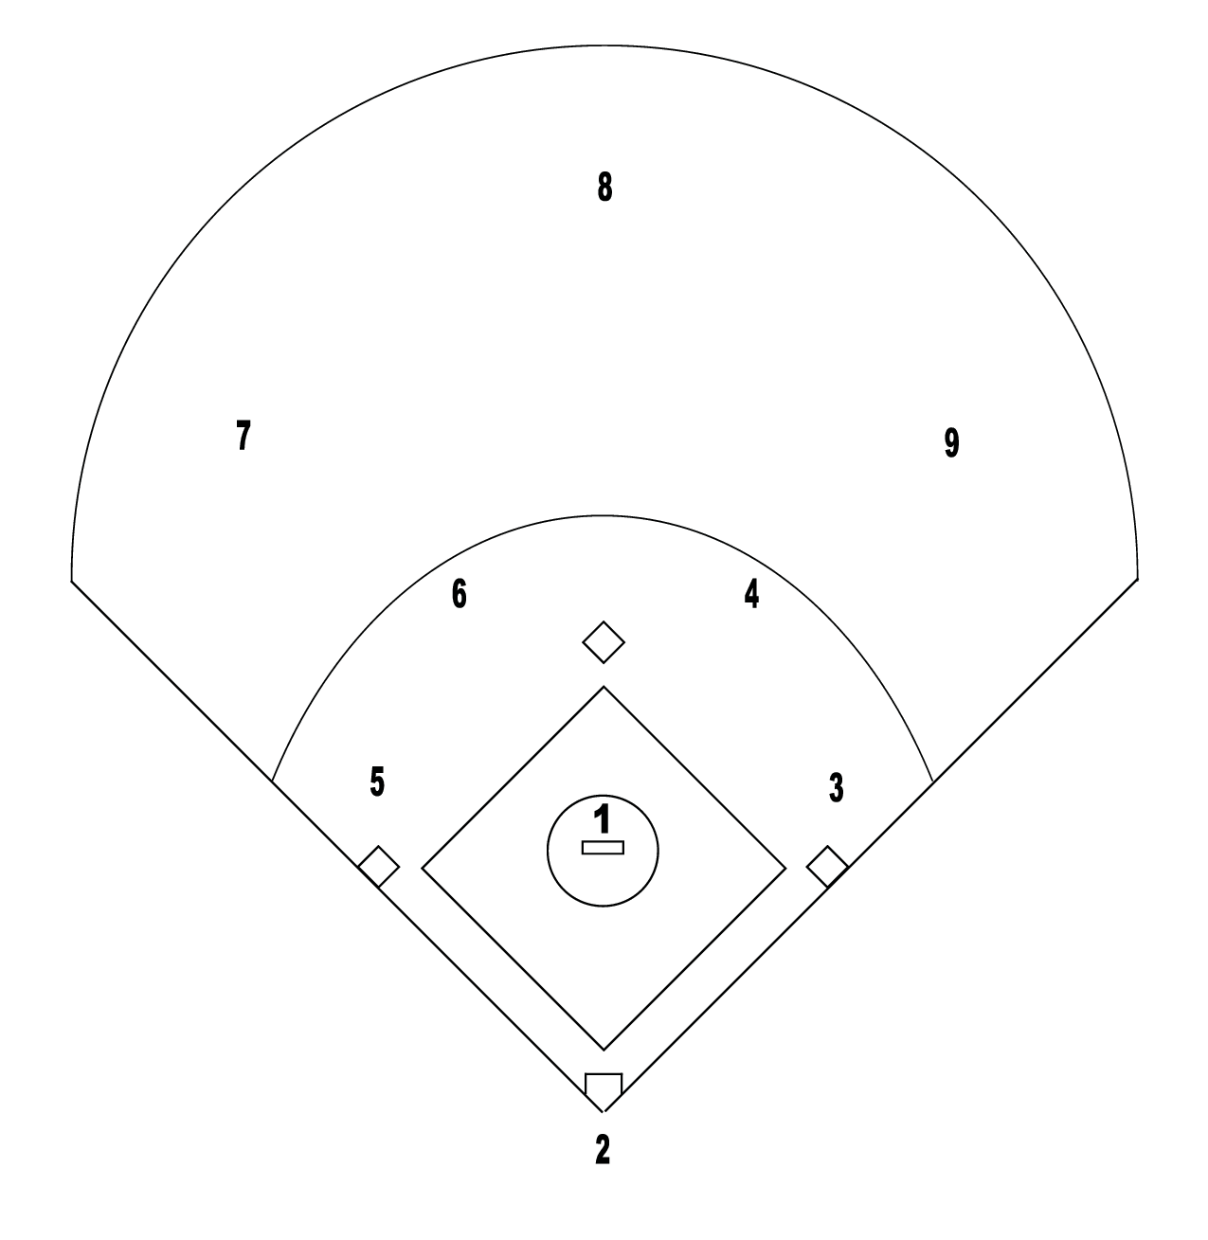
= Ball
= Umpire
= Base Runner

Slide 13
Umpire is Blue
Runner is Red

Slide 14
Umpire is Blue
Runner is Red

Slide 15
Umpire is Blue
Runner is Red

Slide 16
Umpire is Blue
Runner is Red

Slide 17
Umpire is Blue
Runner is Red

Slide 18
Difficult Situations
Two Person System
Bases loaded trouble ball to right center field! What does U2 and UP do?
Runner on 2nd and 3rd- pulled foot (just an inch or two. What now?
Runner on 1st and 3rd- runner leaves a tad early- whose call?
Runner on 3rd, pop up behind catcher, UP doesn’t see it hit backstop- calls a catch?
Batter turns to bunt, flinches get hit – PU doesn’t see it (in strike zone- out of strike zone)??
Three Person System
Bases loaded, trouble ball to left center- runner at 2nd leaves early- who has the call?
No runners on, ball hit to right of center fielder, no catch, runner runs to third- who has the call?
Runners on 2nd and 3rd – fly ball hit down left of 3rd base line, ball caught: runner on 3rd leaves early-whose call?
No one on – ball hit to 5 feet right of center fielder- should/can U3 take the fly? If so- say what?

Slide 19
Wrap Up
Thank you for your discussion, insight and participation.
Having good MECHANICS puts us in the Advanced Skill Level

